Slide 2
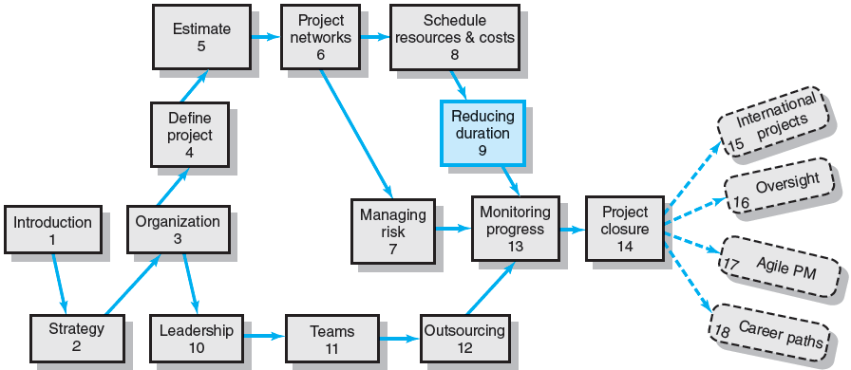
Where We Are Now

Slide 3
Rationale for Reducing Project Duration
Time Is Money: Cost-Time Tradeoffs
Reducing the time of a critical activity usually incurs additional direct costs.
Cost-time solutions focus on reducing (crashing) activities on the critical path to shorten overall duration of the project.
Reasons for imposed project duration dates:
Time-to-market pressures
Unforeseen delays
Incentive contracts (bonuses for early completion)
Imposed deadlines and contract commitments
Overhead and public goodwill costs
Pressure to move resources to other projects

Slide 4
Options for Accelerating Project Completion
Resources Not Constrained
Adding resources
Outsourcing project work
Scheduling overtime
Establishing a core project team
Do it twice—fast and then correctly
Resources Constrained
Fast-tracking
Critical-chain
Reducing project scope
Compromise quality

Slide 5
Explanation of Project Costs
Project Indirect Costs
Costs that cannot be associated with any particular work package or project activity.
Supervision, administration, consultants, and interest
Costs that vary (increase) with time.
Reducing project time directly reduces indirect costs.
Project Direct Costs
Normal costs that can be assigned directly to a specific work package or project activity.
Labor, materials, equipment, and subcontractors
Crashing activities increases direct costs.

Slide 6
Reducing Project Duration to Reduce Project Cost
Identifying direct costs to reduce project time
Gather information about direct and indirect costs of specific project durations.
Search critical activities for lowest direct-cost activities to shorten project duration.
Compute total costs for specific durations and compare to benefits of reducing project time.

Slide 7
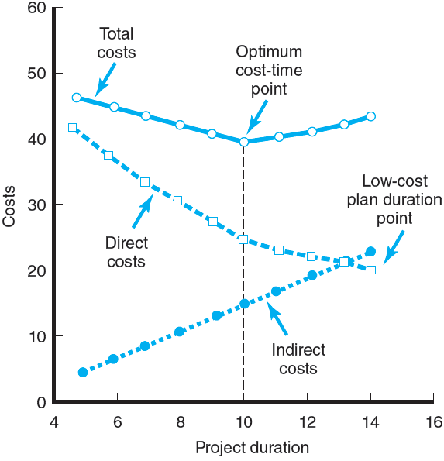
Project Cost–Duration Graph
FIGURE 9.1

Slide 8
Constructing a Project Cost–Duration Graph
Find total direct costs for selected project durations.
Find total indirect costs for selected project durations.
Sum direct and indirect costs for these selected project durations.
Compare additional cost alternatives for benefits.

Slide 9
Constructing a Project Cost–Duration Graph
Determining Activities to Shorten
Shorten the activities with the smallest increase in cost per unit of time.
Assumptions:
The cost relationship is linear.
Normal time assumes low-cost, efficient methods to complete the activity.
Crash time represents a limit—the greatest time reduction possible under realistic conditions.
Slope represents a constant cost per unit of time.
All accelerations must occur within the normal and crash times.

Slide 10
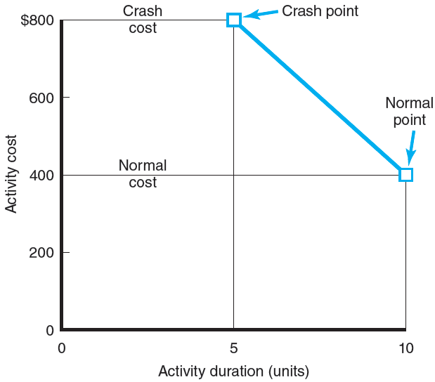
Activity Graph
FIGURE 9.2

Slide 11
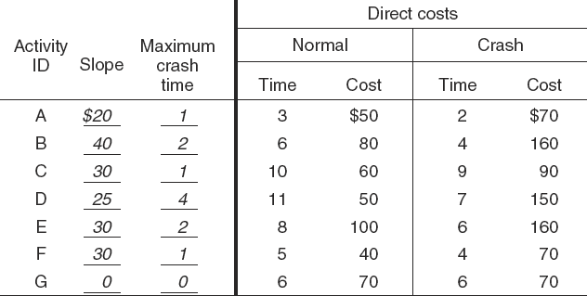
Cost–Duration Trade-off Example
FIGURE 9.3

Slide 12
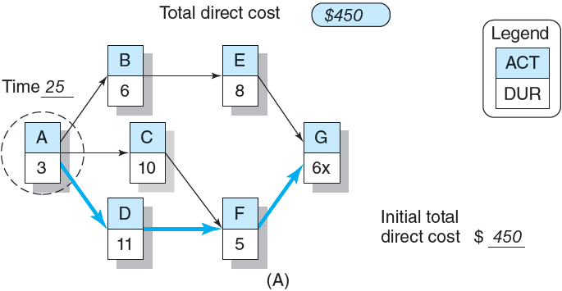
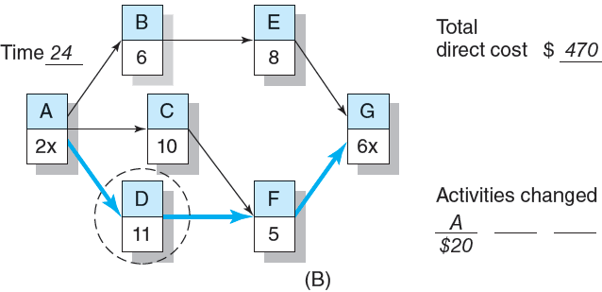
Cost–Duration Trade-off Example (cont’d)
FIGURE 9.3 (cont’d)

Slide 13
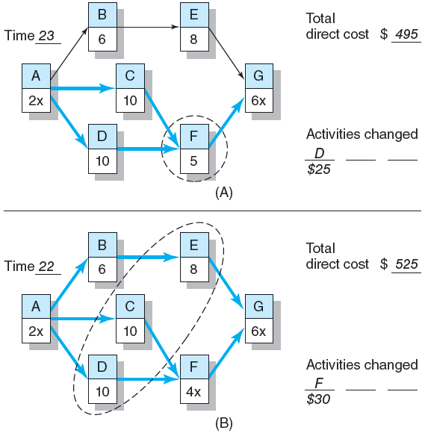
Cost–Duration Trade-off Example (cont’d)
FIGURE 9.4

Slide 14
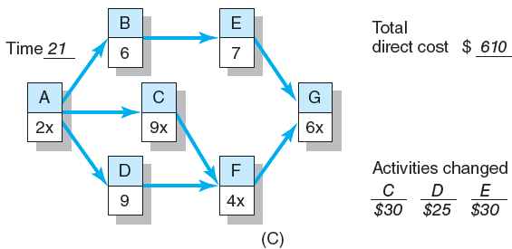
Cost–Duration Trade-off Example (cont’d)
FIGURE 9.4 (cont’d)

Slide 15
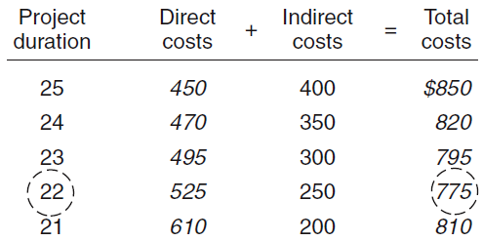
Summary Costs by Duration
FIGURE 9.5

Slide 16
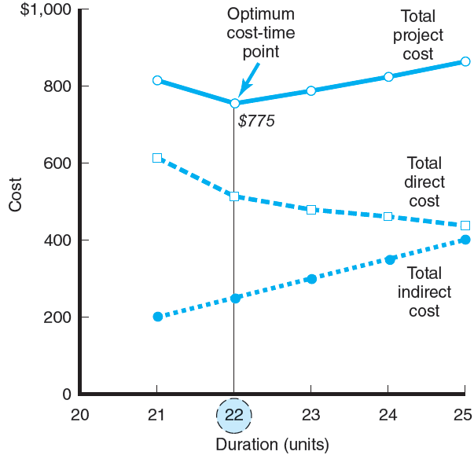
Project Cost–Duration Graph
FIGURE 9.6

Slide 17
Practical Considerations
Using the Project Cost–Duration Graph
Crash Times
Linearity Assumption
Choice of Activities to Crash Revisited
Time Reduction Decisions and Sensitivity

Slide 18
What if Cost, Not Time Is the Issue?
Commonly Used Options for Cutting Costs
Reducing project scope
Having owner take on more responsibility
Outsourcing project activities or even the entire project
Brainstorming cost savings options

Slide 19
Key Terms
Crashing
Crash point
Crash time
Direct costs
Fast-tracking
Indirect costs
Outsourcing
Project cost–duration graph

Slide 20
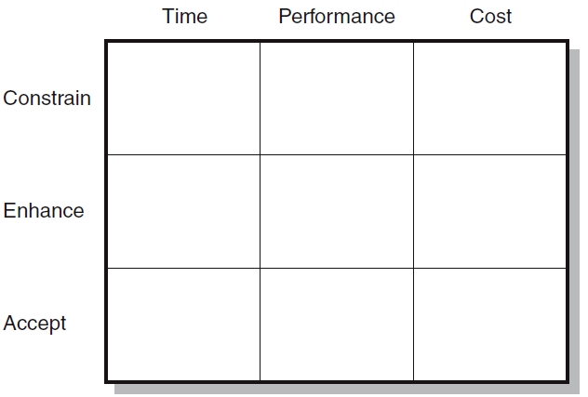
Project Priority Matrix: Whitbread Project
FIGURE C9.1

